Slide 1



DRIVER
MONITORING
SYTEM

Slide 2

Team members:
Ahmed Abdelaal Ahmed Abo-Hadeed.
Ali Nabil Ali .
idris tarek El-Sayed.
Elsayed Sameh Elsayed.
Ahmed Mohmed Gouda.
Rania Yasser Mohamed.
Sherine Ebrahim.
Eman Hamada Abdelhady .
Khloud Elsayed Elsayed.
Supervised by : Dr / Mostafa Abdelsallam
Eng/ Sarah Abdel Mohsen

Slide 3




Outlines
overview
Project Scope
methodology
Q&A

Slide 4



Overview:
Problem Statment
Motivation
Objectives

Slide 5
Problem Statment
What is drowsiness?
Drowsiness is a state of excessive sleepiness or lethargy, impairing alertness and cognitive function.
The effect of Drowsiness on the driver:
Drowsiness is dangerous to the driver as it impairs alertness, reaction time, and decision-making, significantly increasing the risk of accidents.

Slide 6
Motivation:
Drowsiness is a Real Problem With Serious Consequence.
Drowsy Driving accidents Results in over 71,000,and 1500 Deaths .
By detecting Drowsiness and other Sudden Emergencies and warn the Drivers ,they be able to drive long Distance Safely

Slide 7
Objectives:
to identify the driver and detect his/her levels of vigilance through software and alert him/her in cases of drowsiness, distractions, etc. to avert accident.
Determin Risk Levles .
ACT Upon These Levels Through Different Scenario For each Level.

Slide 8


Project Scope:
Scenarios
Featuers

Slide 9
Features

Slide 10

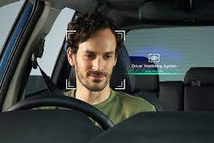
Featuers
⮚The system starts automatically after verifying the driver's identity
⮚Detecting drowsiness level
⮚Actions taken based on drowsiness level

Slide 11

Featuers
⮚Alert system is used according to the level.
⮚Driver can respond to the alert through a responsive touch screen.
⮚Emergency message with location sent
⮚Make emergency call

Slide 12
Scenarios

Slide 13
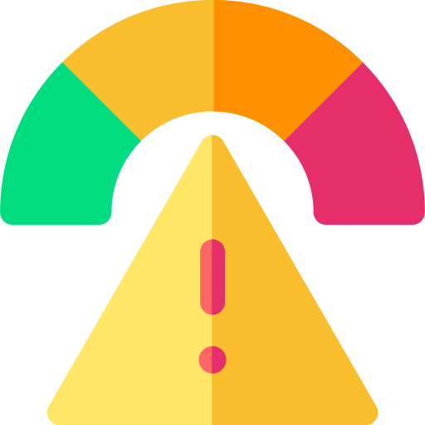
Scenarios
No Risk
Low Risk Level
High Risk Level

Slide 14
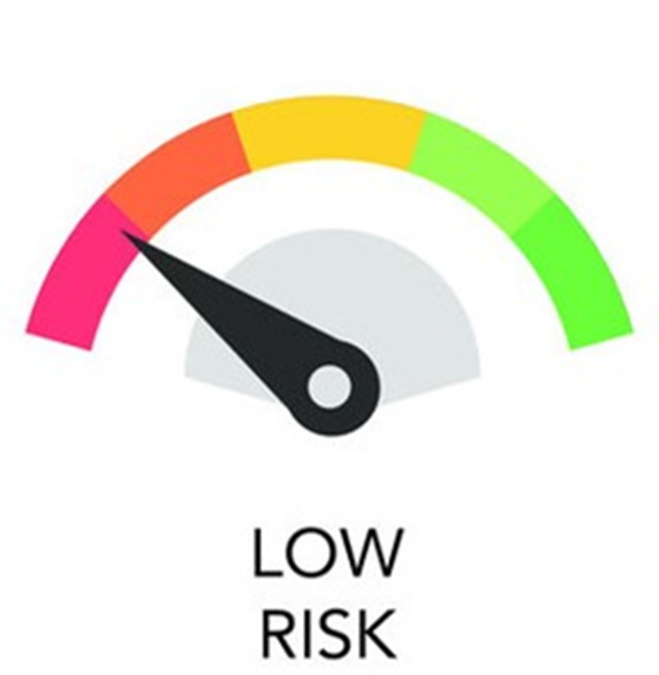
Scenarios : Low Risk
⮚Gentle alarm for 5 seconds
⮚Show a message on screen

Slide 15
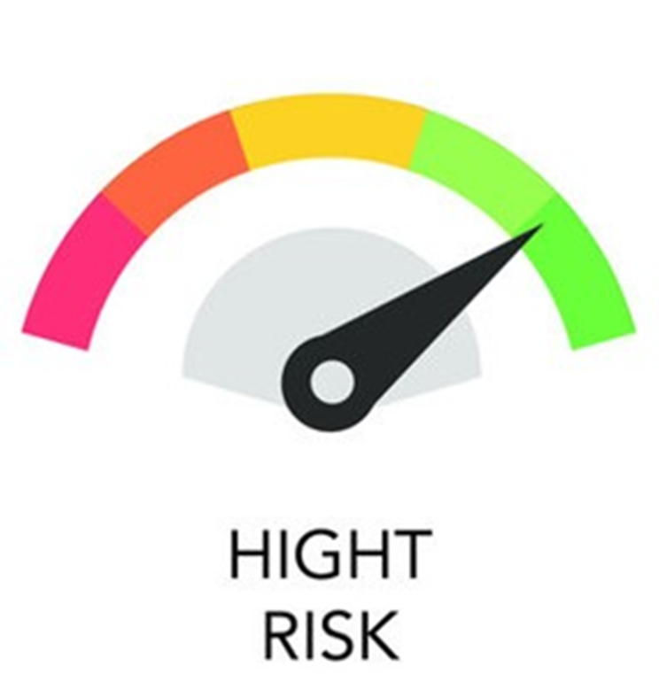



Scenarios : High Risk
⮚Alarm on
⮚Show a message on screen
⮚Response in 10 seconds
⮚Driver can make emergency call
Waiting lights on
Very high alarm (buzzer)
Send SOS message
If no response
If he responds
Buzzer stops
Driver take control

Slide 16
methodology

Slide 17


methodology
P﻿roposed Hardware
Solution Architecture

Slide 18
P﻿roposed Hardware

Slide 19
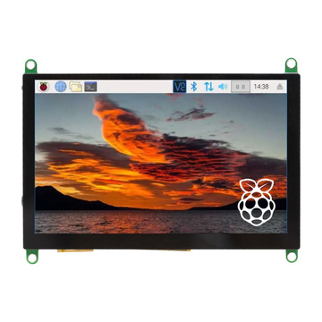
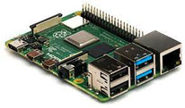
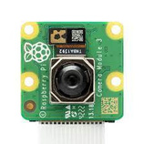
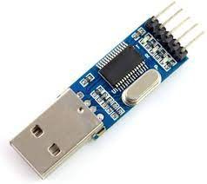
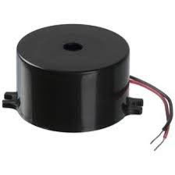
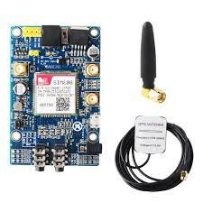
P﻿roposed Hardware
A System-on-a-Chip (SoC) board: is the core of the hardware components since every hardware component is connected to it
Screen: To communicate with the driver behind the wheels
Speakers: The driver is alerted in another way other than a message on the screen, which is a sound played on the speakers
Camera: the camera used for detecting the frames of the driver and send it to the board to make the processing . ex:Raspberry pi Camera
Raspberry pi Camera
USB to TTL Module: he USB to TTL Module is a converter that is used to convert the serial ports into a single USB 2.0 type-A in order to be used by computers that do not have serial ports
BUZZER: The driver is alerted in another way other than a message on the screen, which is a sound played on the speakers
SIM 808 GPS/GSM Module: Since the driver could be already not responding to the alert messages on the screen, a fast action is needed to be taken. To minimize the damage and to prevent the loss of innocent lives, an SOS signal is sent to the emergency operator through the modem. The driver can make an emergency call.

Slide 20
Solution Architecture

Slide 21




Hardware Level
Raspberry pi Camera
Raspberry pi 4 Model B
Touch Screen
BUZZER
GPS/GSM Module SIM808

Slide 22
After the system start , The camera starts taking frames and send it to the SOC like Raspberry pi .
The Raspberry pi makes the processing using AI techniques:
Computer vision like open cv , object detection , MediaPipe and other techniques ... .
Machine learning like KNN ,Support Vector Machines (SVM) ,and other techniques... .
Neural Network and Deep Learning like CNN
to detect:
Verifying the driver's identity .
Driver Drowsiness levels .
Drivers Expression if he is nervous or on mode that doesn't make him Naturel the system send alert .
And detect what is the action Driver do if he Smoking or drinking or eating the System sent alarm and suggest to Take A break until he finishing from his action.
And system can Detect Driver Eye Blink Frequency , Eye Location (Right ,Left),Head position and Zone , Gaze Direction and Zone .
after detect these techniques we can detect the level of Drowsiness and The driver's concentration while driving
if is the high level of Drowsiness and Distraction the driver send alert on screen and make high alarm using sound system

Slide 23
Q&A

